Slide 1

HBase

Slide 2
Apache Hadoop projects
Pig—A high-level data flow language
Hive—A SQL-like data warehouse infrastructure
HBase—A distributed, column-oriented database modeled after Google’s Bigtable
ZooKeeper—A reliable coordination system for managing shared state between distributed applications
Chukwa—A data collection system for managing large distributed systems

Slide 3
HBase: History
November 2006
Google releases paper on BigTable
February 2007
Initial HBase prototype created as Hadoop contrib
October 2007
First “usable” HBase (Hadoop 0.15.0)
January 2008
Hadoop becomes an Apache top-level project, HBase becomes subproject

Slide 4
HBase: Overview
HBase is a distributed column-oriented data store built on top of HDFS
HBase is an Apache open source project whose goal is to provide storage for the Hadoop Distributed Computing
Data is logically organized into tables, rows and columns
Notes:
the Hadoop database. It’s often described as a sparse, distributed,
persistent, multidimensional sorted map,
it’s a platform for storing
and retrieving data with random access,

Slide 5
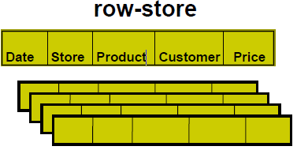
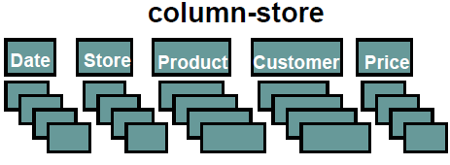
Row-Oriented vs Column-Oriented
+ easy to add/modify a record
- might read in unnecessary data
+ only need to read in relevant data
- tuple writes require multiple accesses

Slide 6
Column-Oriented database
suitable for read-mostly, read-intensive, large data repositories
Data Warehousing
High end (clustering)
Mid end/Mass Market
Personal Analytics
Data Mining
Scientific datasets
SciDB initiative
SLOAN Digital Sky Survey on MonetDB
Notes:
l Google BigTable
l RDF
l Semantic web data management
l Information retrieval
l Terabyte TREC
MonetDB has been applied in high-performance applications for data mining, online analytical processing (OLAP), geographic information systems,[1] RDF,[2] streaming data processing,[3] text and multimedia retrieval.

Slide 7
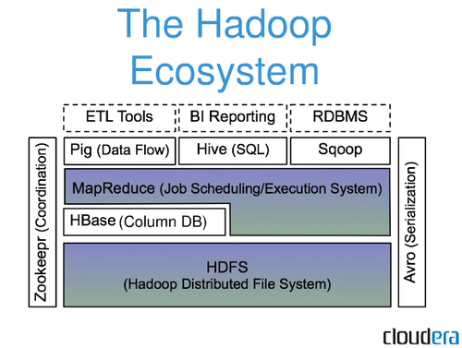
HBase: Part of Hadoop’s Ecosystem
HBase is built on top of HDFS
HBase files are internally stored in HDFS

Slide 8
Zookeeper: Part of Hadoop’s Ecosystem
A highly available, scalable, distributed, configuration, consensus, group membership, leader election, naming, and coordination service
modeled after Google’s Chubby
ZooKeeper Service
Leader
Server
Server
Server
Server
Server
Server
Client
Client
Client
Client
Client
Client
Client
Client

Slide 9
HBase Architecture

Slide 10
Three Major Components
The HBaseMaster
One master
The HRegionServer
Many region servers
The HBase client

Slide 11
HBase Components
Region
A subset of a table’s rows, like horizontal range partitioning
Automatically done
RegionServer (many slaves)
Manages data regions
Serves data for reads and writes (using a log)
Master
Responsible for coordinating the slaves
Assigns regions, detects failures
Admin functions

Slide 12
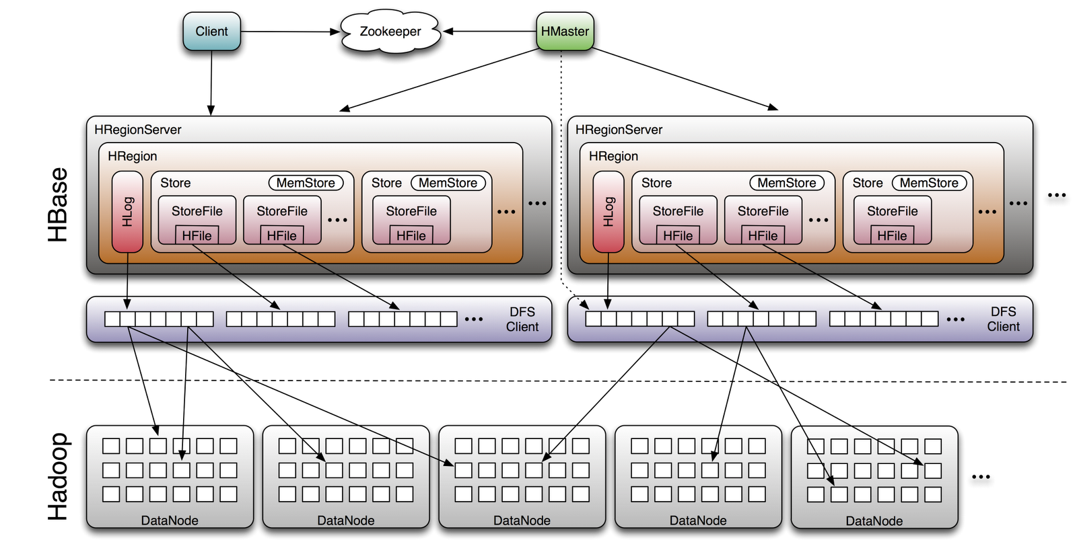
Big Picture

Slide 13
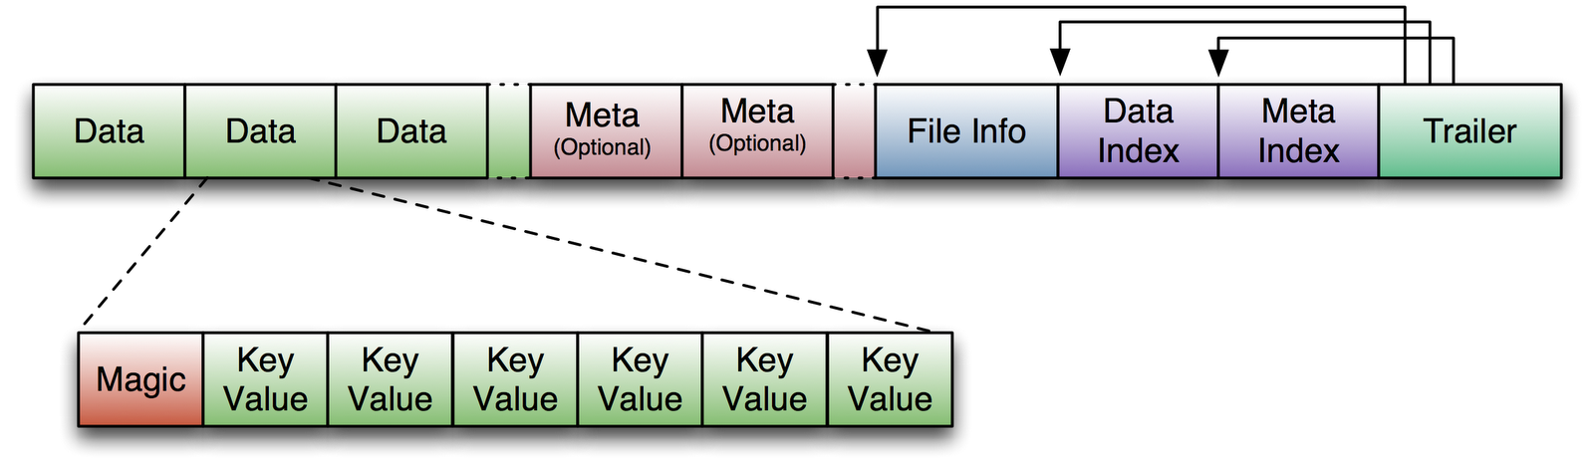
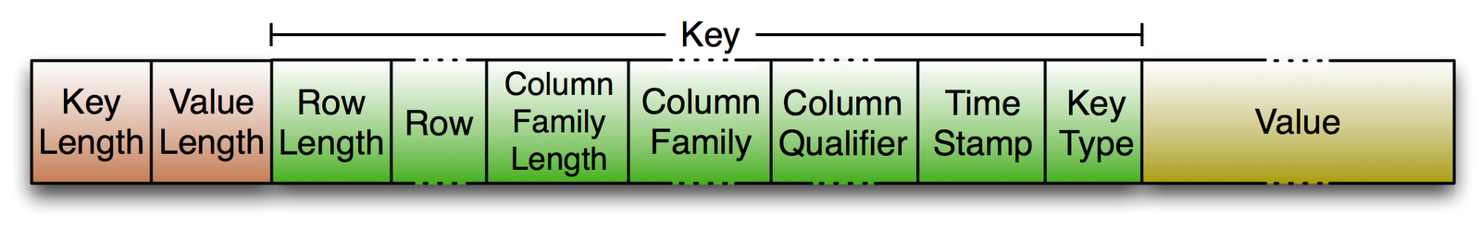
HFile
(For a census table example)
SSN:000-00-0000
Ethnicity
Demographic
Source: http://blog.cloudera.com/blog/2012/06/hbase-io-hfile-input-output/

Slide 14
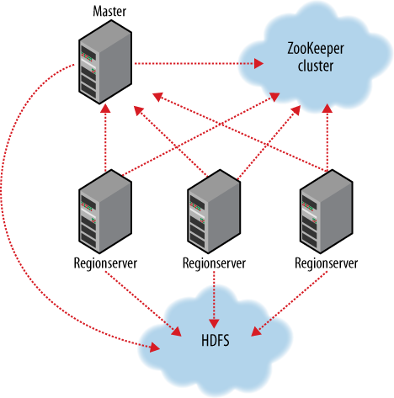
ZooKeeper
HBase depends on ZooKeeper
By default HBase manages the ZooKeeper instance
E.g., starts and stops ZooKeeper
HMaster and HRegionServers register themselves with ZooKeeper
Notes:
ZooKeeper is modeled after Google’s Chubby
tracking of region servers, where the root region is hosted
/hbase/hbaseid
Contains the cluster ID, as stored in the hbase.id file on HDFS. For example:
[zk: localhost(CONNECTED) 1] get /hbase/hbaseid
e627e130-0ae2-448d-8bb5-117a8af06e97
/hbase/master
Holds the server name

Slide 15
Data Model and Manipulation

Slide 16
Data Model
Table—HBase organizes data into tables
Row—Within a table, data is stored according to its row
Column family—Data within a row is grouped by column family
Column qualifier—Data within a column family is addressed via its column qualifier
Cell—A combination of rowkey, column family, and column qualifier uniquely identifies a cell
Version—Values within a cell are versioned.

Slide 17
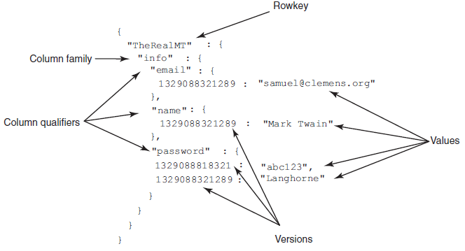
Logical model: sorted map of maps
Notes:
HBase logically organizes data as a nested map of maps.
Within each map, data is physically sorted by that map’s key. In this example, "email"
comes before "name" and more recent versions come before older ones.

Slide 18
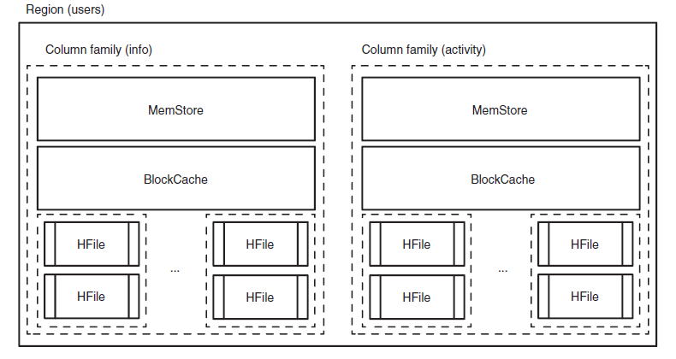
Physical model: column family oriented
Notes:
A region in the users table. All data for a given row in the table is managed together in
a region.

Slide 19
Physical model: HFile data
"TheRealMT" , "info" , "email" , 1329088321289 , "samuel@clemens.org“
"TheRealMT" , "info" , "name", 1329088321289 , "Mark Twain“
"TheRealMT" , "info" , "password" , 1329088818321 , "abc123",
"TheRealMT" , "info" , "password", , 1329088321289 "Langhorne"
Notes:
"TheRealMT" , "info" , "email" , 1329088321289 , "samuel@clemens.org“
"TheRealMT" , "info" , "name", 1329088321289 , "Mark Twain“
"TheRealMT" , "info" , "password" , 1329088818321 , "abc123",
"TheRealMT" , "info" , "password", , 1329088321289 "Langhorne"

Slide 20
Creating a Table
HBaseAdmin admin= new HBaseAdmin(config);
HColumnDescriptor []column;
column= new HColumnDescriptor[2];
column[0]=new HColumnDescriptor("columnFamily1:");
column[1]=new HColumnDescriptor("columnFamily2:");
HTableDescriptor desc= new HTableDescriptor(Bytes.toBytes("MyTable"));
desc.addFamily(column[0]);
desc.addFamily(column[1]);
admin.createTable(desc);

Slide 21
Creating a Table
$ hbase shell
HBase Shell; enter 'help<RETURN>' for list of supported commands.
Type "exit<RETURN>" to leave the HBase Shell
Version 0.92.0, r1231986, Mon Jan 16 13:16:35 UTC 2012
hbase(main):001:0>
hbase(main):001:0> create 'users', 'info'
0 row(s) in 0.1200 seconds

Slide 22
Examine table schema
hbase(main):002:0> list
TABLE
users
1 row(s) in 0.0220 seconds
hbase(main):003:0> describe 'users'
DESCRIPTION ENABLED
{NAME => 'users', FAMILIES => [{NAME => 'info', true
BLOOMFILTER => 'NONE', REPLICATION_SCOPE => '0
', COMPRESSION => 'NONE', VERSIONS => '3', TTL
=> '2147483647', BLOCKSIZE => '65536', IN_MEMOR
Y => 'false', BLOCKCACHE => 'true'}]}
1 row(s) in 0.0330 seconds

Slide 23
Establish a connection
HTableInterface usersTable = new HTable("users");
Configuration myConf = HBaseConfiguration.create();
HTableInterface usersTable = new HTable(myConf, "users");
myConf.set("parameter_name", "parameter_value");

Slide 24
Connection management
HTablePool pool = new HTablePool();
HTableInterface usersTable = pool.getTable("users");
... // work with the table
usersTable.close();

Slide 25
Data manipulation
Storing data
Modifying data
Reading data
Deleting data
Scanning data
five basic commands:
Get, Put, Delete, Scan, Increment

Slide 26
Storing data
Put p = new Put(Bytes.toBytes("TheRealMT"));
p.add(Bytes.toBytes("info"),
Bytes.toBytes("name"),
Bytes.toBytes("Mark Twain"));
p.add(Bytes.toBytes("info"),
Bytes.toBytes("email"),
Bytes.toBytes("samuel@clemens.org"));
p.add(Bytes.toBytes("info"),
Bytes.toBytes("password"),
Bytes.toBytes("Langhorne"));

Slide 27
Storing data
HTableInterface usersTable = pool.getTable("users");
Put p = new Put(Bytes.toBytes("TheRealMT"));
p.add(...);
usersTable.put(p);
usersTable.close();

Slide 28
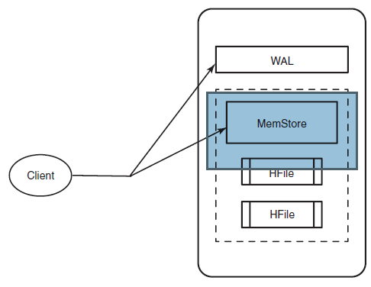
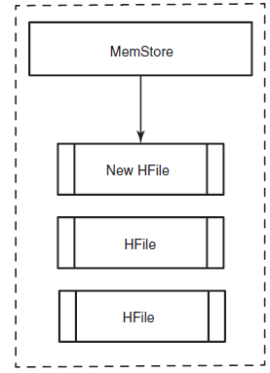
Modifying data
WAL: Write Ahead Log
MemStore: a write buffer where HBase accumulates data in memory
Notes:
Every write to HBase requires confirmation from both the WAL and
the MemStore. The two steps ensure that every write to HBase happens as fast as possible while
maintaining durability. The MemStore is flushed to a new HFile when it fills up.
one MemStore per column family

Slide 29
Reading data
Get g = new Get(Bytes.toBytes("TheRealMT"));
g.addColumn(
Bytes.toBytes("info"),
Bytes.toBytes("password"));
Result r = usersTable.get(g);

Slide 30
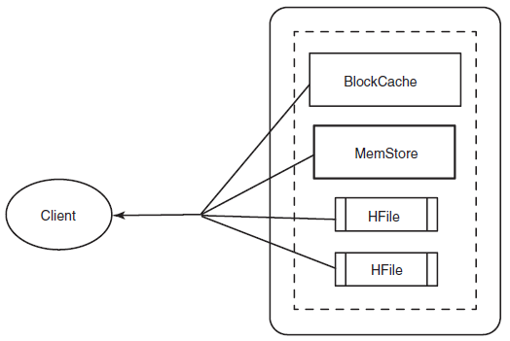
Reading data
BlockCache: LRU cache for reads
The “Block” in BlockCache is the unit of data that
The HFile is physically laid out as a sequence of blocks plus an index over those blocks.
Notes:
Reading a row from HBase requires first checking the MemStore for any pending
modifications. Then the BlockCache is examined to see if the block containing this
row has been recently accessed. Finally, the relevant HFiles on disk are accessed.

Slide 31
Deleting data
Delete d = new Delete(Bytes.toBytes("TheRealMT"));
d.deleteColumns(
Bytes.toBytes("info"),
Bytes.toBytes("email"));
usersTable.delete(d);

Slide 32
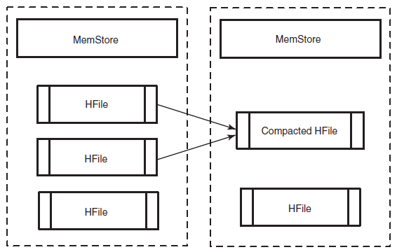
Compactions: HBase housekeeping
Records are read from the existing HFiles and combined into a single, merged HFile
Notes:
Records are read from the existing HFiles and combined into a single,
merged HFile. That new HFile is then marked as the new canonical data on disk, and the old HFiles
are deleted. When a compaction is run simultaneously over all HFiles in a column family, it’s called a
major compaction.

Slide 33
Versioned data
List<KeyValue> passwords = r.getColumn(
Bytes.toBytes("info"),
Bytes.toBytes("password"));
b = passwords.get(0).getValue();
String currentPasswd = Bytes.toString(b); // "abc123"
b = passwords.get(1).getValue();
String prevPasswd = Bytes.toString(b); // "Langhorne"
Notes:
Every time you perform an operation on a cell, HBase implicitly stores a new version.
Creating, modifying, and deleting a cell are all treated identically; they’re all new versions.
Get requests reconcile which version to return based on provided parameters.
The version is used as the final coordinate when accessing a specific cell value.
By default, HBase stores only the last three versions;
this is configurable per column family

Slide 34
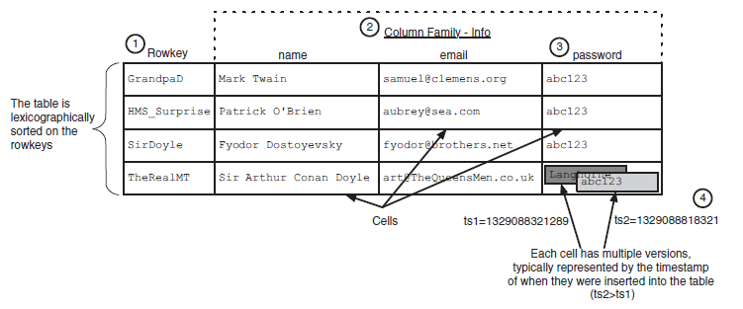
Data coordinates
HBase stores a piece of data in a table based on a 4D coordinate system.
The coordinates used by HBase, in order, are
rowkey, column family, column qualifier, and version.

Slide 35
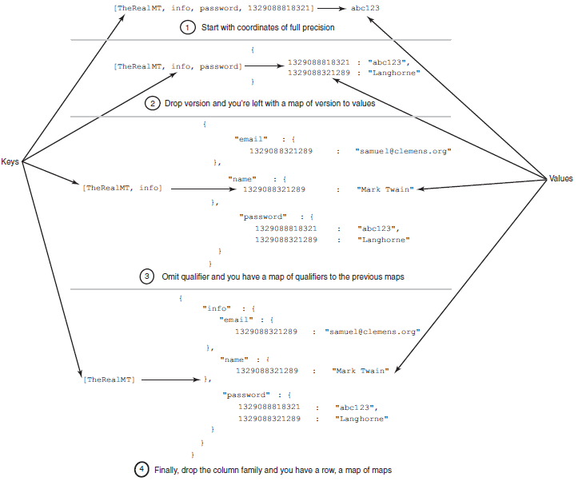
views of HBase as a key-value data store

Slide 36
Putting it all together
package HBaseIA.TwitBase.model;
public abstract class User {
public String user;
public String name;
public String email;
public String password;
@Override
public String toString() {
return String.format("<User: %s, %s, %s>", user, name, email);
}
}

Slide 37
CRUD operations in UsersDAO.java
package HBaseIA.TwitBase.hbase;
//...
public class UsersDAO {
public static final byte[] TABLE_NAME = Bytes.toBytes("users");
public static final byte[] INFO_FAM = Bytes.toBytes("info");
private static final byte[] USER_COL = Bytes.toBytes("user");
private static final byte[] NAME_COL = Bytes.toBytes("name");
private static final byte[] EMAIL_COL = Bytes.toBytes("email");
private static final byte[] PASS_COL = Bytes.toBytes("password");
public static final byte[] TWEETS_COL = Bytes.toBytes("tweet_count");
private HTablePool pool;

Slide 38
public UsersDAO(HTablePool pool) {
this.pool = pool;
}
private static Get mkGet(String user) {
Get g = new Get(Bytes.toBytes(user));
g.addFamily(INFO_FAM);
return g;
}
private static Put mkPut(User u) {
Put p = new Put(Bytes.toBytes(u.user));
p.add(INFO_FAM, USER_COL, Bytes.toBytes(u.user));
p.add(INFO_FAM, NAME_COL, Bytes.toBytes(u.name));
p.add(INFO_FAM, EMAIL_COL, Bytes.toBytes(u.email));
p.add(INFO_FAM, PASS_COL, Bytes.toBytes(u.password));
return p;
}
private static Delete mkDel(String user) {
Delete d = new Delete(Bytes.toBytes(user));
return d;
}

Slide 39
public void addUser(String user,
String name, String email, String password) throws IOException {
HTableInterface users = pool.getTable(TABLE_NAME);
Put p = mkPut(new User(user, name, email, password));
users.put(p);
users.close();
}
public HBaseIA.TwitBase.model.User getUser(String user) throws IOException {
HTableInterface users = pool.getTable(TABLE_NAME);
Get g = mkGet(user);
Result result = users.get(g);
if (result.isEmpty()) { return null; }
User u = new User(result);
users.close();
return u;
}

Slide 40
public void deleteUser(String user) throws IOException {
HTableInterface users = pool.getTable(TABLE_NAME);
Delete d = mkDel(user);
users.delete(d);
users.close();
}

Slide 41
Table scans
“Query”
Scan s = new Scan();
Scan the users with IDs starting with the letter T through U
Scan s = new Scan(
Bytes.toBytes("T"),
Bytes.toBytes("U"));
Notes:
The only way to access records containing a specific value is by using
the Scan command to read across some portion of the table, applying a filter to
retrieve only the relevant records. As you might imagine, the records returned while
scanning are presented in sorted order.

Slide 42
Atomic operations
Increment Column Value Command
Java AtomicLong.addAndGet() method
to change an integral value stored in an HBase cell without reading it back first
long ret = usersTable.incrementColumnValue(
Bytes.toBytes("TheRealMT"),
Bytes.toBytes("info"),
Bytes.toBytes("tweet_count"),
1L);

Slide 43
Executing a scan
byte[] userHash = Md5Utils.md5sum(user);
byte[] startRow = Bytes.padTail(userHash, longLength); // 212d...866f00...
byte[] stopRow = Bytes.padTail(userHash, longLength);
stopRow[Md5Utils.MD5_LENGTH-1]++; // 212d...867000...
Scan s = new Scan(startRow, stopRow);
ResultsScanner rs = twits.getScanner(s);
Notes:
you create the stop key by incrementing the value of the last byte of the
user ID portion of the rowkey. Scanners return records inclusive of the start key and
exclusive of the end key, so this gives you twits for only the matching user.

Slide 44
Applying filters ValueFilter
Scan s = new Scan();
s.addColumn(Bytes.toBytes("twits"), Bytes.toByes("twit"));
Filter f = new ValueFilter(
CompareOp.EQUAL,
new RegexStringComparator(".*TwitBase.*"));
s.setFilter(f);

Slide 45
Applying filters ParseFilter
Scan s = new Scan();
s.addColumn(TWITS_FAM, TWIT_COL);
String expression = "ValueFilter(=,'regexString:.*TwitBase.*')";
ParseFilter p = new ParseFilter();
Filter f = p.parseSimpleFilterExpression(Bytes.toBytes(expression));
s.setFilter(f);

Slide 46
HBase is not an ACID-compliant database
Operations are row-level atomic
Inter-row operations are not atomic
Any Get() operation on a given row returns the complete row as it exists at that point in time in the system.
Multiple write operations to a given row are always independent of each other in their entirety.
A scan across a table is not a scan over a snapshot of the table at any point.
Notes:
Atomicity
an operation is atomic if it either completes entirely or not at all
Consistency
all actions cause the table to transition from one valid state directly to another (eg a row will not disappear during an update, etc)
Isolation
an operation is isolated if it appears to complete independently of any other concurrent transaction
Durability
any update that reports "successful" to the client will not be lost
Visibility
an update is considered visible if any subsequent read will see the update as having been committed

Slide 47
Hbase and Hadoop

Slide 48
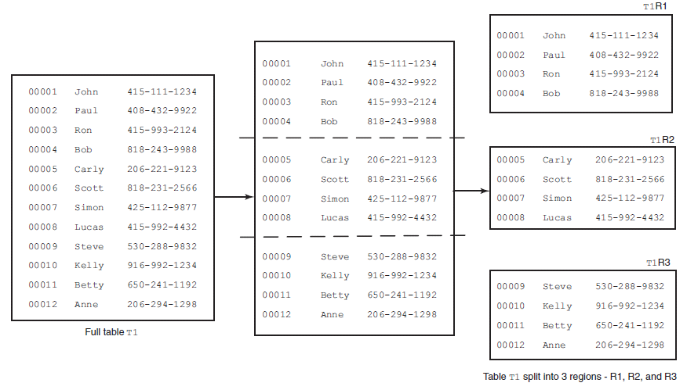
HBase in distributed mode
Notes:
A table consists of multiple smaller chunks called regions.
The size of individual regions is governed by the configuration parameter hbase.hregion.
max.filesize, which can be configured in the hbase-site.xml file of your
deployment.

Slide 49
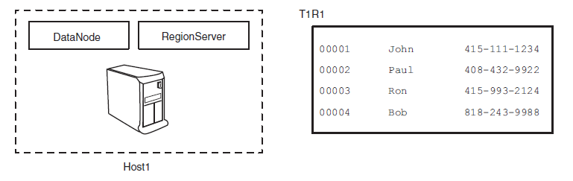
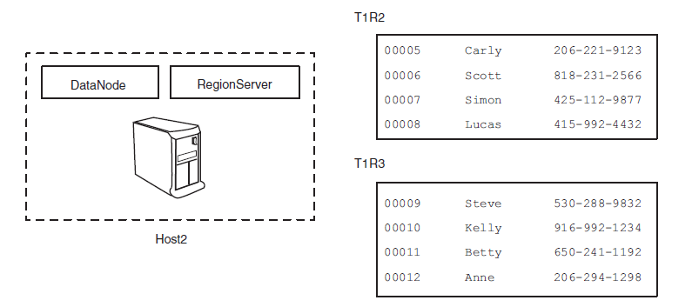
HBase in distributed mode

Slide 50
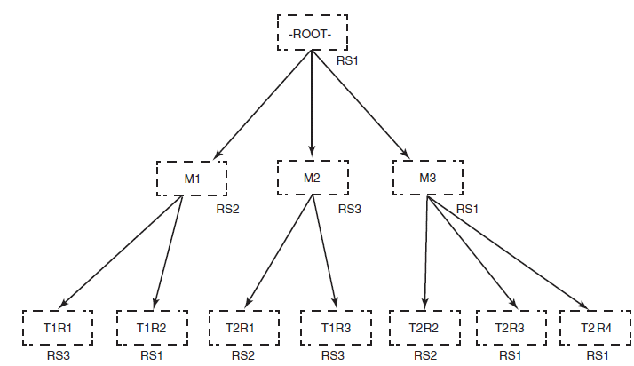
special Hbase tables
-ROOT- points it to the region of the .META. table that contains the answer to that question.
.META. table consists of entries that the client application uses to determine
which RegionServer is hosting the region in question.
Notes:
-ROOT- table, consisting
of only one region hosted
.META. table, consisting
of three regions, hosted
User tables T1 and T2,
consisting of three and
RS1
RS2
T2R1
RS2
T2R2
RS2
T2R3
RS1
RS3 RS1
T1R1
RS3
T1R3
RS3
T1R2
RS1
T2 R4
RS1
on RegionServer RS1
on RS1, RS2, and RS3
four regions respectively,
distributed among RS1,
RS2, and RS3

Slide 51
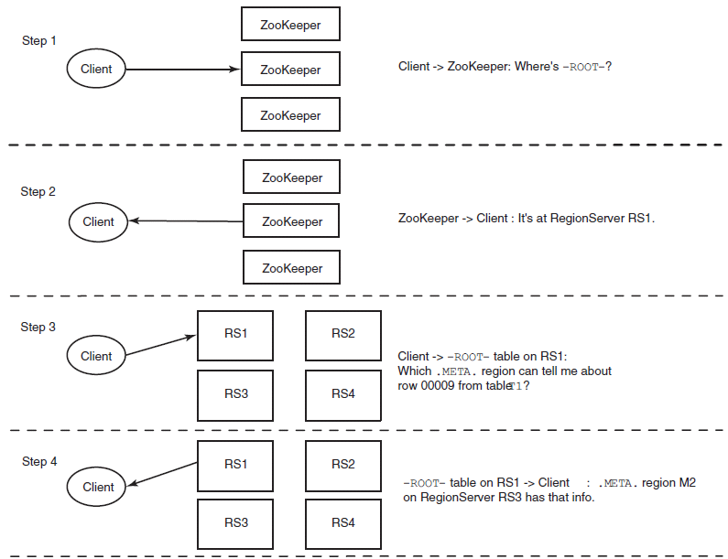
Interaction with HBase

Slide 52
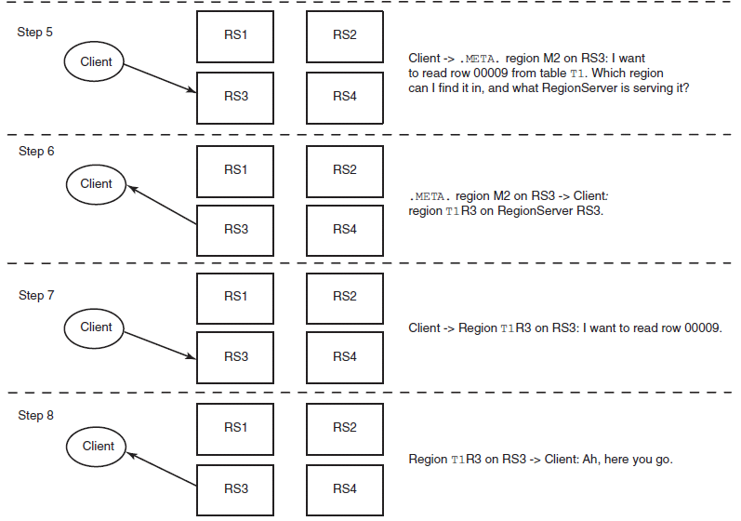
Interaction with HBase

Slide 53
Hbase and Map-Reduce
three different ways of interacting with HBase
from a MapReduce application
HBase as a source
HBase as a sink
HBase as a shared resource
Notes:
HBase is an online system driven by low latency, Hadoop is
an offline system optimized for throughput.
HBase is designed for MapReduce interaction; it provides a TableMapper and a
TableReducer to ease implementation of MapReduce applications. The

Slide 54
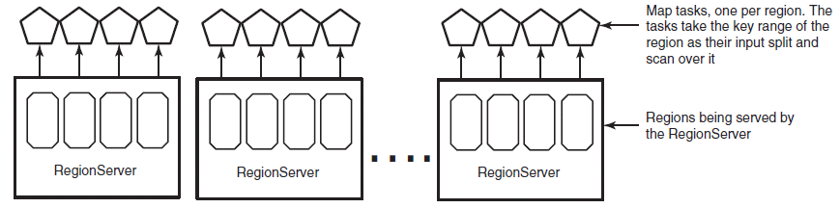
HBase as a source
Scan scan = new Scan();
scan.addColumn(Bytes.toBytes("twits"), Bytes.toBytes("twit"));
protected void map(
ImmutableBytesWritable rowkey,
Result result,
Context context) {
...
}
Notes:
The next step is to take your Scan instance and wire it into MapReduce. HBase provides
the handy TableMapReduceUtil class to help you initialize the Job instance:
TableMapReduceUtil.initTableMapperJob(
"twits",
scan,
Map.class,
ImmutableBytesWritable.class,
Result.class,
job);

Slide 55
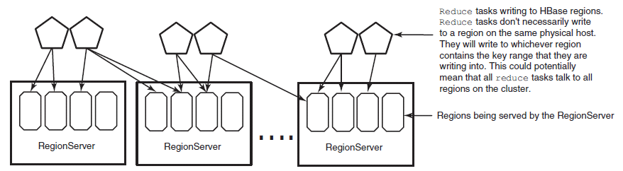
HBase as a sink
protected void reduce(
ImmutableBytesWritable rowkey,
Iterable<Put> values,
Context context) {
...
}
Notes:
TableMapReduceUtil.initTableReducerJob(
"users",
IdentityTableReducer.class,
job);

Slide 56
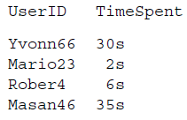
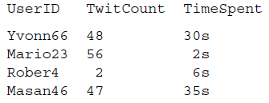
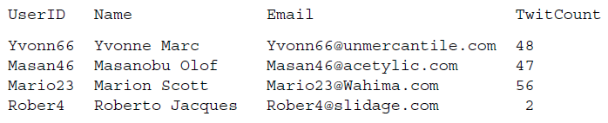
HBase as a shared resource

Slide 57
HBase as a shared resource Reduce-side join
map_timespent(line_num, line):
userid, timespent = split(line)
record = {"TimeSpent" : timespent,
"type" : "TimeSpent"}
emit(userid, record)
map_users(line_num, line):
userid, name, email, twitcount = split(line)
record = {"TwitCount" : twitcount,
"type" : "TwitCount"}
emit(userid, record)
reduce(userid, records):
for rec in records:
rec.del("type")
merge(records)
emit(userid, ratio(rec["TimeSpent"], rec["TwitCount"]))

Slide 58
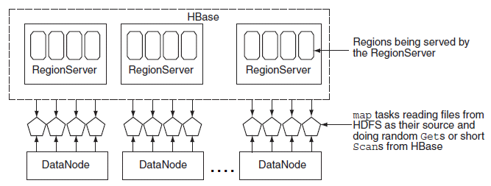
HBase as a shared resource
map-side join
map_timespent(line_num, line):
users_table = HBase.connect("Users")
userid, timespent = split(line)
record = {"TimeSpent" : timespent}
record = merge(record, users_table.get(userid, "info:twitcount"))
emit(userid, ratio(record["TimeSpent"], record["info:twitcount"]))

Slide 59
Writing a MapReduce application with HBase
package HBaseIA.TwitBase.mapreduce;
//...
public class CountShakespeare {
public static class Map
extends TableMapper<Text, LongWritable> {
public static enum Counters {ROWS, SHAKESPEAREAN};
private boolean containsShakespeare(String msg) {
//...
}

Slide 60
Writing a MapReduce application with HBase
@Override
protected void map( ImmutableBytesWritable rowkey, Result result,
Context context) {
byte[] b = result.getColumnLatest(
TwitsDAO.TWITS_FAM,
TwitsDAO.TWIT_COL).getValue();
String msg = Bytes.toString(b);
if (msg != null && !msg.isEmpty())
context.getCounter(Counters.ROWS).increment(1);
if (containsShakespeare(msg))
context.getCounter(Counters.SHAKESPEAREAN).increment(1);
}
}

Slide 61
Writing a MapReduce application with HBase
public static void main(String[] args) throws Exception {
Configuration conf = HBaseConfiguration.create();
Job job = new Job(conf, "TwitBase Shakespeare counter");
job.setJarByClass(CountShakespeare.class);
Scan scan = new Scan();
scan.addColumn(TwitsDAO.TWITS_FAM, TwitsDAO.TWIT_COL);
TableMapReduceUtil.initTableMapperJob(
Bytes.toString(TwitsDAO.TABLE_NAME),
scan, Map.class, ImmutableBytesWritable.class, Result.class,
job);
job.setOutputFormatClass(NullOutputFormat.class);
job.setNumReduceTasks(0);
System.exit(job.waitForCompletion(true) ? 0 : 1);
}
}
Notes:
It also takes advantage of the HBase-specific MapReduce helper class
TableMapper and the TableMapReduceUtil utility class

Slide 62
Hbase Application Examples

Slide 63
OpenTSDB
Using HBase as an online time-series database
Special properties of time-series data
Designing an HBase schema for time series
Storing and querying HBase using a complex rowkey

Slide 64
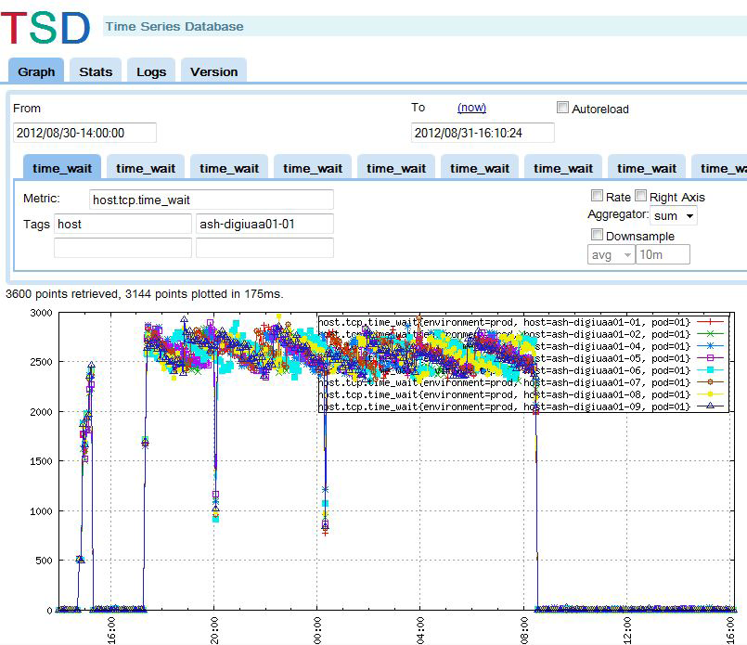
An overview of OpenTSDB
a distributed, scalable Time Series Database (TSDB) written on top of HBase.
Notes:
System Monitoring :
store, index, and serve metrics collected from computer systems at a large scale
OpenTSDB is optimized for metric-centric queries

Slide 65
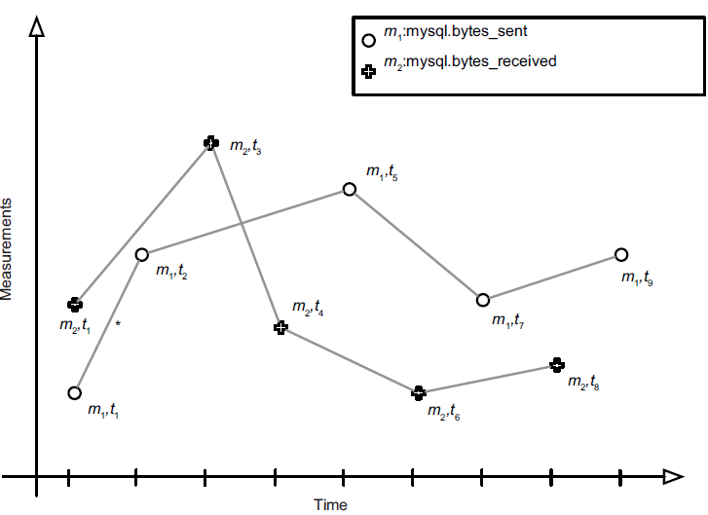
Data: time series
Notes:
Time-series data can be challenging from a data-management perspective. All data
points in a system may share the same fields, for instance: date/time, location, and
measurement.
Another notable issue with time series is in recording this data. Trees are an efficient
data structure for random access, but special care must be taken when building
them in sorted order.

Slide 66
OpenTSDB: Schema design
#!/bin/sh
# Small script to setup the hbase table used by OpenTSDB.
test -n "$HBASE_HOME" || {
echo >&2 'The environment variable HBASE_HOME must be set'
exit 1
}
test -d "$HBASE_HOME" || {
echo >&2 "No such directory: HBASE_HOME=$HBASE_HOME"
exit 1
}
TSDB_TABLE=${TSDB_TABLE-'tsdb'}
UID_TABLE=${UID_TABLE-'tsdb-uid'}
COMPRESSION=${COMPRESSION-'LZO'}
exec "$HBASE_HOME/bin/hbase" shell <<EOF
create '$UID_TABLE',
{NAME => 'id', COMPRESSION => '$COMPRESSION'},
{NAME => 'name', COMPRESSION => '$COMPRESSION'}
create '$TSDB_TABLE',
{NAME => 't', COMPRESSION => '$COMPRESSION'}
EOF

Slide 67
DECLARING THE SCHEMA
tsdb-uid table
contains two column families: [ id, name ]
UID management ( UIDs : fixed 3-byte width )
Tsdb table
a column family [ t ]
the lengths of the column-family is short
Hfile storage format
Notes:
The tsdb-uid table contains two column families: id and name.
The tsdb table also
specifies a column family, named t.
mysql.bytes_sent and
mysql.bytes_received, receives its own unique ID (UID) in this table.
The tsdb-uid table is for UID management. UIDs are of a fixed 3-byte width and
used in a foreign-key relationship from the tsdb table
names are all pretty short. This is because of an implementation detail of the HFile
storage format of the current version of HBase—shorter names mean less data to store
per KeyValue instance.

Slide 68
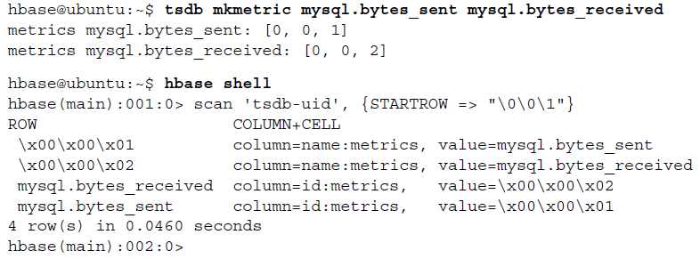
Registering metrics in the tsdb-uid table
UID-to-Name
NAME-to-UID

Slide 69
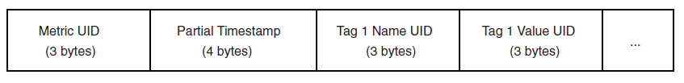
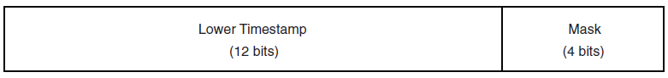
TSDB Layout
The layout of an OpenTSDB rowkey consists of 3 bytes for the metric id, 4 bytes for the high-order timestamp bits, and 3 bytes each for the tag name ID and tag value ID, repeated
Column qualifiers store the final precision of the timestamp as well as a bitmask.
The first bit in that mask indicates whether the value in the cell is an integer or a float value.
Notes:
THE TSDB TABLE
This is the heart of the time-series database: the table that stores time series of measurements
and metadata. This table is designed to support queries of this data filtered
by date range and tag.
OpenTSDB uses a 2-byte column qualifier consisting of two parts: the rounded seconds in the first 12 bits
and a 4-bit bitmask. The measurement value is stored on 8 bytes in the cell.

Slide 70
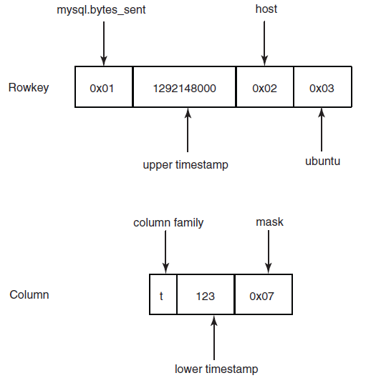
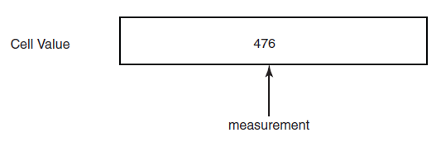
An example rowkey,
column qualifier, and cell value storing
476 mysql.bytes_sent at
1292148123 seconds in the tsdb
table.

Slide 71
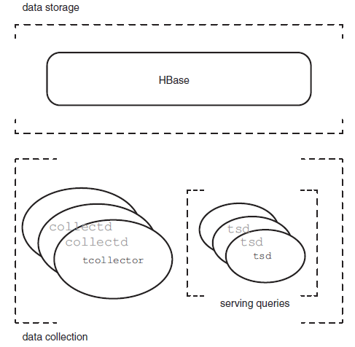
Application architecture
Data collection
Data storage
Serving queries
Notes:
OpenTSDB includes a process called tsd for handling interactions with HBase. It
exposes a simple HTTP interface2 for serving queries against HBase. Requests can
query for either metadata or an image representing the requested time series. All tsd
processes are identical and stateless, so high availability is achieved by running multiple
tsd machines.

Slide 72
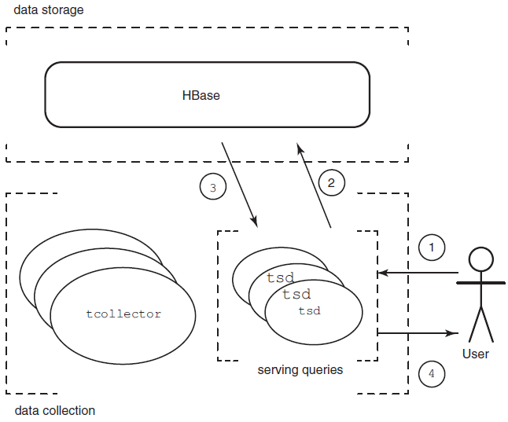
OpenTSDB read path
User specifies query parameters.
tsd constructs filter and requests range scan.
HBase scans key range, omitting filtered records, and returns results.
tsd renders time series.

Slide 73
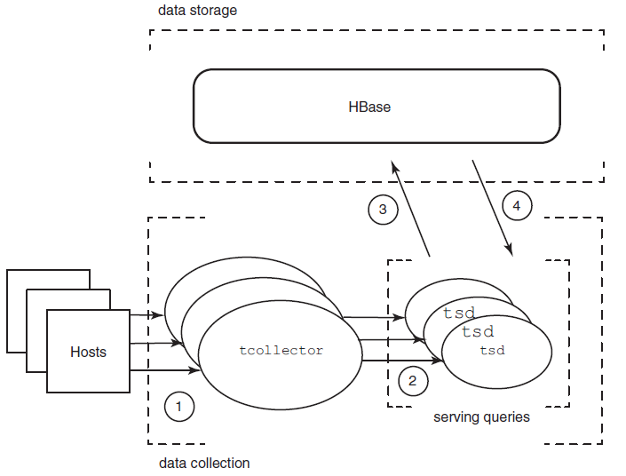
OpenTSDB write path
1 Hosts report measurements to local collectd.
collectd sends measurements to remote tsd.
tsd constructs record and puts data to HBase.
HBase stores data and acknowledges put request.
Notes:
The tcollector3 daemon, also running on each monitored host, takes care of these
concerns by gathering measurements locally. It’s responsible for ensuring that observations
are delivered to OpenTSDB by waiting out such a network outage. It also manages
collection scripts, running them on the appropriate interval or restarting them
when they crash. As an added bonus, collection agents written for tcollector can be
simple shell scripts.

Slide 74
Scaling GIS on HBase
Notes:
Geographic Information
Systems (GIS). GIS is an interesting area of exploration because it poses two significant
challenges: latency at scale and modeling spatial locality.
The idea is to store data so that all the information about a place on Earth is stored close
together. That way, when you want to investigate that location, you need to make as
few data requests as possible.

Slide 75
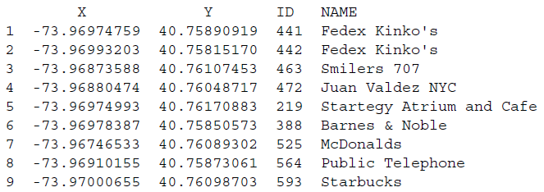
Designing a spatial index
Notes:
“Where’s the nearest wifi hotspot?”

Slide 76
Find the wifi
design of the rowkey is the single most important thing
concatenating X- and Y-axis values as the rowkey??
Notes:
concatenating X- and Y-axis values as the rowkey??

Slide 77
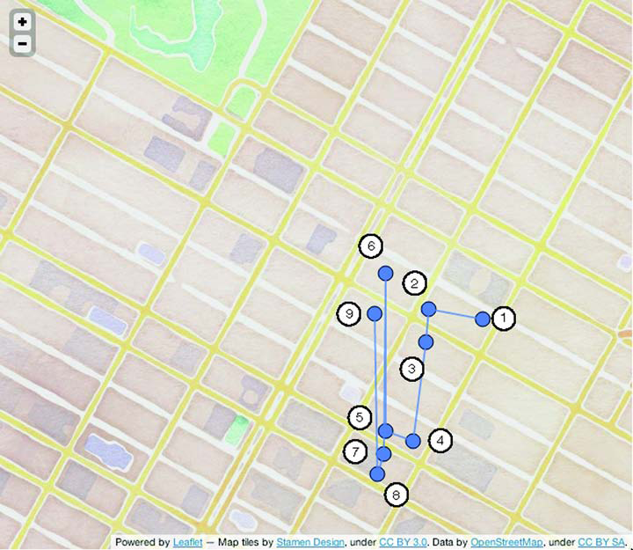
A naïve approach to spatial schema design: concatenated axes values.

Slide 78
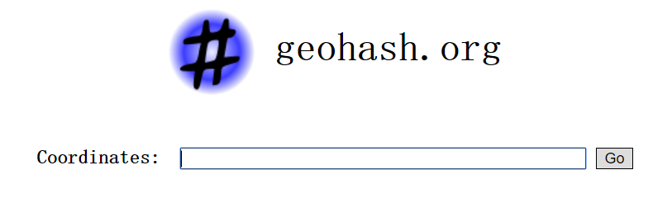
geohash
a function that turns some number of values into a single value.
The longitude dimension ~ [-180.0, 180.0]
The latitude dimension ~ [-90.0, 90.0]
For example, the coordinate pair 57.64911,10.40744 (near the tip of the peninsula of Jutland, Denmark) produces a slightly shorter hash of u4pruydqqvj.
Notes:
For a given geohash prefix, all points within that space match the common prefix.
If you can fit your query inside a geohash prefix’s bounding box, all matching points
will share a common prefix. That means you can use HBase’s prefix scan on the
rowkeys to get back a set of points that are all relevant to the query. That accomplishes
goal B. But as figure 8.4 illustrates, if you have to choose an overly generous precision,
you’ll end up with much more data than you need.

Slide 79
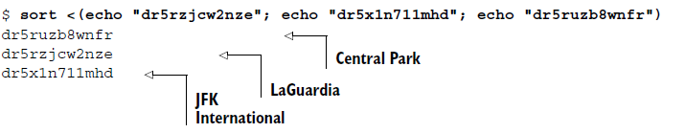
Truncating a geohash
By dropping characters from the end of a geohash, you drop
precision from the space that hash represents.

Slide 80
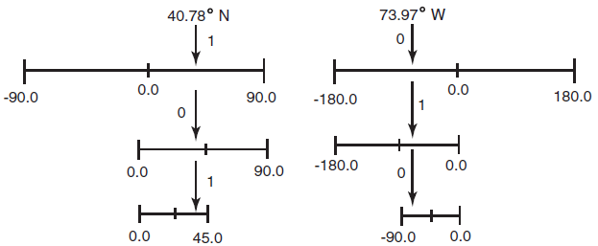
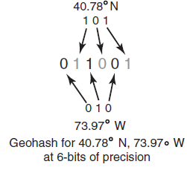
Constructing a geohash
The first 3 bits from longitude and latitude are calculated
and woven to produce a geohash of 6-bit precision.

Slide 81
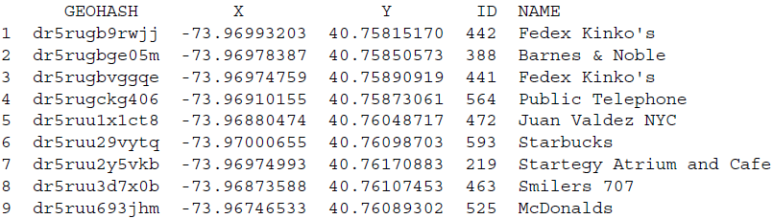
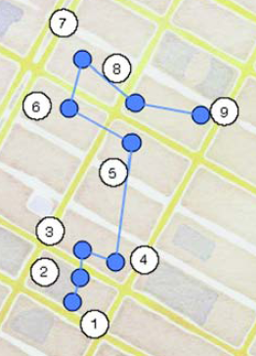
Using the geohash as a spatially aware rowkey
Common Prefix:
dr5ru

Slide 82
Implementing the nearest-neighbors query
public Collection<QueryMatch> queryKNN(double lat, double lon, int n) {
1 Construct the target GeoHash.
2 Iterate through it and its eight neighbors to find candidate results.
3 Rank and limit the results of the nine scans to compute the final n results
returned to the caller
}

Slide 83
Prefix matches with geohash overlay
Notes:
Lots of additional, unnecessary area is introduced
into the query result by using the 6-character prefix. An ideal implementation would use
only 7-character prefixes to minimize the amount of extra data transmitted over the wire.

Slide 84
Implementing the nearest-neighbors query
takeN(origin, prefix, n):
table = HBase.table('wifi')
scanner = table.scan(prefix)
results = []
for result in scanner:
results.add(result)
comp = distance_from(origin)
results = sort(comp, results)
return limit(n, results)
queryKNN(lat, lon, n):
origin = [lat, lon]
target = geohash(lat, lon)
results = []
results.addAll(takeN(origin, target, n)
for neighbor in target.neighbors:
results.addAll(takeN(origin, neighbor, n)
comp = distance_from(origin)
results = sort(comp, results)
return limit(n, results)
Notes:
The queryKNN function handles generating the geohash from the query target, calculating
the nine prefixes to scan, and consolidating the results.

Slide 85
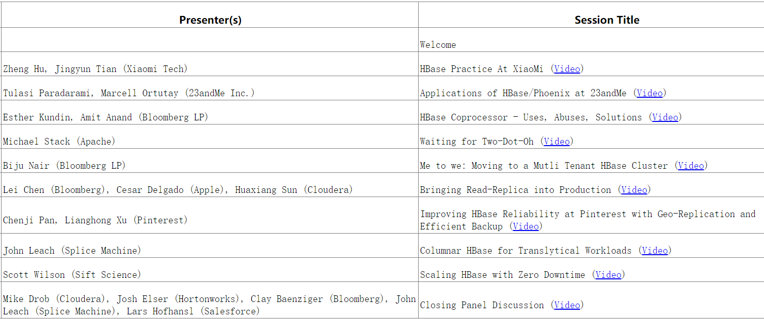
THE COMMUNITY EVENT FOR APACHE HBASE™
https://hbase.apache.org/hbasecon-archives.html
Notes:
http://hbase.apache.org/book.html

